Slide 1
Course – Database Management Systems (DBMS)
Course Instructor
Dr. K. Subrahmanyam
Department of CSE,KLU

Slide 2
DML statements
SELECT - extracts data from a database
UPDATE - updates data in a database
DELETE - deletes data from a database
INSERT INTO - inserts new data into a database

Slide 3
The INSERT INTO Statement
The INSERT INTO statement is used to insert a new row in a table.
SQL INSERT INTO Syntax
It is possible to write the INSERT INTO statement in two forms.
The first form doesn't specify the column names where the data will be inserted, only their values:
INSERT INTO table_name
VALUES (value1, value2, value3,...)
The second form specifies both the column names and the values to be inserted:
INSERT INTO table_name (column1, column2, column3,...)
VALUES (value1, value2, value3,...)

Slide 4
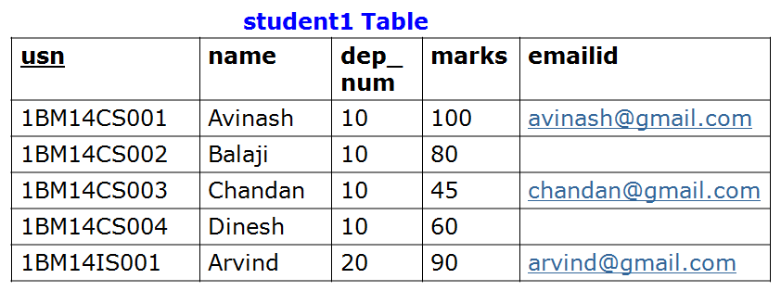
SQL UPDATE Statement
The UPDATE statement is used to update existing records in a table.
SQL UPDATE Syntax
UPDATE table_name
SET column1=value, column2=value2,...
WHERE some_column=some_value
update student1
set emailid=‘dinesh@gmail.com’
where name=‘Dinesh’;

Slide 5
Topics Covered in Todays Class
- Schema change statements in SQL
- Basic SQL queries

Slide 6
Schema change statements in SQL
Drop command can be used to drop tables or constraints.
The DROP TABLE Statement
General Syntax: DROP TABLE table_name
The DROP DATABASE Statement
General Syntax: DROP DATABASE database_name
The TRUNCATE TABLE Statement
What if we only want to delete the data inside the table, and not the table itself ? Then, use the TRUNCATE TABLE statement:
General Syntax: TRUNCATE TABLE table_name

Slide 7
Schema change statements in SQL
student Table
Drop command
department Table
USN | Name | Dep_num
1BM14CS001 | Avinash | 10
1BM14CS002 | Balaji | 10
1BM14CS003 | Ram | 10
1BM14CS004 | Mohan | 20
1BM14CS005 | Nikil | 20
D_ID | Dep_name
10 | CSE
20 | ISE
Assume the above two tables were created using following create commands
create table department (D_ID integer, Dep_name varchar(3),primary key (D_ID));
create table student (USN varchar(10),Name varchar(20),Dep_num integer,
primary key(usn),foreign key (Dep_num) references department(D_ID));
Note: Assume after above two table creation, values shown above are inserted
into tables
Notes:
create table department (D_ID integer, Dep_name varchar(3),primary key (D_ID));
create table student (USN varchar(10),Name varchar(2),Dep_num integer,primary key(usn),foreign key (Dep_num) references department(D_ID));
insert into department values(10,'CSE'); insert into department values(20,'ISE');

Slide 8
Schema change statements in SQL
student Table
Drop command
department Table
USN | Name | Dep_num
1BM14CS001 | Avinash | 10
1BM14CS002 | Balaji | 10
1BM14CS003 | Ram | 10
1BM14CS004 | Mohan | 20
1BM14CS005 | Nikil | 20
D_ID | Dep_name
10 | CSE
20 | ISE
Question
When the following SQL Command is executed, what will be the output
insert into student values (‘1BM14CS006’,’Patel’,50);
Notes:
Cannot add or update a child row: a foreign key constraint fails (`dbms_jan_2016`.`student`, CONSTRAINT `student_ibfk_1` FOREIGN KEY (`Dep_num`) REFERENCES `department` (`D_ID`))

Slide 9
Schema change statements in SQL
student Table
Drop command
department Table
USN | Name | Dep_num
1BM14CS001 | Avinash | 10
1BM14CS002 | Balaji | 10
1BM14CS003 | Ram | 10
1BM14CS004 | Mohan | 20
1BM14CS005 | Nikil | 20
D_ID | Dep_name
10 | CSE
20 | ISE
Question
When the following SQL Command is executed, what will be the output
insert into student values (‘1BM14CS006’,’Patel’,50);
Cannot add a row: a foreign key constraint fails
Notes:
Cannot add or update a child row: a foreign key constraint fails (`dbms_jan_2016`.`student`, CONSTRAINT `student_ibfk_1` FOREIGN KEY (`Dep_num`) REFERENCES `department` (`D_ID`))

Slide 10
Schema change statements in SQL
student Table
Drop command
department Table
USN | Name | Dep_num
1BM14CS001 | Avinash | 10
1BM14CS002 | Balaji | 10
1BM14CS003 | Ram | 10
1BM14CS004 | Mohan | 20
1BM14CS005 | Nikil | 20
D_ID | Dep_name
10 | CSE
20 | ISE
Question
When the following SQL Command is executed, what will be the output
drop table department;
Notes:
Cannot delete or update a parent row: a foreign key constraint fails

Slide 11
Schema change statements in SQL
student Table
Drop command
department Table
USN | Name | Dep_num
1BM14CS001 | Avinash | 10
1BM14CS002 | Balaji | 10
1BM14CS003 | Ram | 10
1BM14CS004 | Mohan | 20
1BM14CS005 | Nikil | 20
D_ID | Dep_name
10 | CSE
20 | ISE
Question
When the following SQL Command is executed, what will be the output
drop table department;
Department Table will not be deleted because of foreign key constraint
Notes:
Cannot delete or update a parent row: a foreign key constraint fails

Slide 12
Schema change statements in SQL
student Table
Drop command
department Table
USN | Name | Dep_num
1BM14CS001 | Avinash | 10
1BM14CS002 | Balaji | 10
1BM14CS003 | Ram | 10
1BM14CS004 | Mohan | 20
1BM14CS005 | Nikil | 20
D_ID | Dep_name
10 | CSE
20 | ISE
Question
When the following SQL Command is executed, what will be the output
drop table student;
Notes:
Cannot delete or update a parent row: a foreign key constraint fails

Slide 13
Schema change statements in SQL
student Table
Drop command
department Table
USN | Name | Dep_num
1BM14CS001 | Avinash | 10
1BM14CS002 | Balaji | 10
1BM14CS003 | Ram | 10
1BM14CS004 | Mohan | 20
1BM14CS005 | Nikil | 20
D_ID | Dep_name
10 | CSE
20 | ISE
Question
When the following SQL Command is executed, what will be the output
drop table student;
student Table will be deleted
Notes:
Cannot delete or update a parent row: a foreign key constraint fails

Slide 14
Schema change statements in SQL
student Table
Drop command
department Table
USN | Name | Dep_Num
1BM14CS001 | Avinash | 10
1BM14CS002 | Balaji | 10
1BM14CS003 | Ram | 10
1BM14CS004 | Mohan | 20
1BM14CS005 | Nikil | 20
D_ID | Dep_name
10 | CSE
20 | ISE
Question
When the following SQL Command is executed, what will be the output
drop table department cascade constraints;
Notes:
Table dropped
Mysql
SET foreign_key_checks = 0;
drop table department;
SET foreign_key_checks = 1;
# MySQL returned an empty result set (i.e. zero rows).
SET foreign_key_checks = 0;# MySQL returned an empty result set (i.e. zero rows). drop table department;# MySQL returned an empty result set (i.e. zero rows). SET foreign_key_checks= 1;# MySQL returned an empty result set (i.e. zero rows).

Slide 15
Schema change statements in SQL
student Table
Drop command
department Table
USN | Name | Dep_Num
1BM14CS001 | Avinash | 10
1BM14CS002 | Balaji | 10
1BM14CS003 | Ram | 10
1BM14CS004 | Mohan | 20
1BM14CS005 | Nikil | 20
D_ID | Dep_name
10 | CSE
20 | ISE
Question
When the following SQL Command is executed, what will be the output
drop table department cascade constraints;
Department Table will be deleted and foreign key constraint to student
Table will be dropped
Notes:
Table dropped
Mysql
SET foreign_key_checks = 0;
drop table department;
SET foreign_key_checks = 1;
# MySQL returned an empty result set (i.e. zero rows).
SET foreign_key_checks = 0;# MySQL returned an empty result set (i.e. zero rows). drop table department;# MySQL returned an empty result set (i.e. zero rows). SET foreign_key_checks= 1;# MySQL returned an empty result set (i.e. zero rows).

Slide 16
Schema change statements in SQL
Student Table
Drop command
department Table
USN | Name | Dep_Num
1BM14CS001 | Avinash | 10
1BM14CS002 | Balaji | 10
1BM14CS003 | Ram | 10
1BM14CS004 | Mohan | 20
1BM14CS005 | Nikil | 20
D_ID | Dep_name
10 | CSE
20 | ISE
Question
Whether the following two SQL commands will be executed successfully
drop table department cascade constraints;
insert into student values (‘1BM14CS006’,’Patel’,50);
Notes:
Row inserted

Slide 17
Schema change statements in SQL
student Table
Drop command
department Table
USN | Name | Dep_Num
1BM14CS001 | Avinash | 10
1BM14CS002 | Balaji | 10
1BM14CS003 | Ram | 10
1BM14CS004 | Mohan | 20
1BM14CS005 | Nikil | 20
D_ID | Dep_name
10 | CSE
20 | ISE
Question
Whether the following two SQL commands will be executed successfully
drop table department cascade constraints;
insert into student values (‘1BM14CS006’,’Patel’,50);
Into the student table new row will be inserted with dep_num 50
Notes:
Row inserted

Slide 18
Schema change statements in SQL
Drop Command
General syntax:
drop table table_name [drop_behavior]
There are two drop behavior options
1. Cascade: All constraints that references the table are dropped automatically along with the table itself.
2. Restrict: Table is dropped only it is not referenced in any constraints.

Slide 19
Schema change statements in SQL
Alter command
General Syntax:
alter table table_name [add|drop|alter] column column_name;
Adding or dropping column
Changing column definition
Adding or dropping table constraints

Slide 20
Schema change statements in SQL
Alter command
Student Table
USN | Name | Dep_Num
1BM14CS001 | Avinash | 10
1BM14CS002 | Balaji | 10
1BM14CS003 | Ram | 10
1BM14CS004 | Mohan | 20
1BM14CS005 | Nikil | 20
Notes:
Table altered, dep_num column will be deleted

Slide 21
Schema change statements in SQL
Alter command
Student Table
USN | Name | Dep_Num
1BM14CS001 | Avinash | 10
1BM14CS002 | Balaji | 10
1BM14CS003 | Ram | 10
1BM14CS004 | Mohan | 20
1BM14CS005 | Nikil | 20
Notes:
Table altered

Slide 22
Schema change statements in SQL
Alter command
Student Table
USN | Name | Dep_Num
1BM14CS001 | Akash | 10
1BM14CS002 | Bharath | 10
1BM14CS003 | Ragu | 10
1BM14CS004 | Mohan | 20
1BM14CS005 | Nikil | 20
Question
What will be the contents of the student table when the following SQL
commands are executed ?

Slide 23
Schema change statements in SQL
Alter command
Student Table
USN | S-Name | Dep_Num | email
1BM14CS001 | Akash | 10
1BM14CS002 | Bharath | 10
1BM14CS003 | Ragu | 10
1BM14CS004 | Mohan | 20
1BM14CS005 | Nikil | 20
1BM14CS006 | Patel | 10 | patel@gmail.com

Slide 24
Basic queries in SQL
To retrieve data from database table, basic SQL statement is SELECT
Syntax:
select column_name_list
from table_name
where condition;

Slide 25
SQL select statement
student Table
usn | name | dep_num | marks
1BM14CS001 | Avinash | 10 | 100
1BM14CS002 | Balaji | 10 | 80
1BM14CS003 | Chandan | 10 | 45
1BM14CS004 | Dinesh | 10 | 60
1BM14IS001 | Avinash | 20 | 90

Slide 26
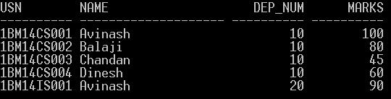
SQL select statement
Student Table
usn | name | dep_num | marks
1BM14CS001 | Avinash | 10 | 100
1BM14CS002 | Balaji | 10 | 80
1BM14CS003 | Chandan | 10 | 45
1BM14CS004 | Dinesh | 10 | 60
1BM14IS001 | Avinash | 20 | 90

Slide 27

SQL select statement
Student Table
usn | name | dep_num | marks
1BM14CS001 | Avinash | 10 | 100
1BM14CS002 | Balaji | 10 | 80
1BM14CS003 | Chandan | 10 | 45
1BM14CS004 | Dinesh | 10 | 60
1BM14IS001 | Avinash | 20 | 90

Slide 28

SQL select statement
Student Table
usn | name | dep_num | marks
1BM14CS001 | Avinash | 10 | 100
1BM14CS002 | Balaji | 10 | 80
1BM14CS003 | Chandan | 10 | 45
1BM14CS004 | Dinesh | 10 | 60
1BM14IS001 | Avinash | 20 | 90

Slide 29
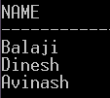
SQL select statement
Student Table
usn | name | dep_num | marks
1BM14CS001 | Avinash | 10 | 100
1BM14CS002 | Balaji | 10 | 80
1BM14CS003 | Chandan | 10 | 45
1BM14CS004 | Dinesh | 10 | 60
1BM14IS001 | Avinash | 20 | 90

Slide 30
Select statement
Where clause conditions
=
!=
<
>
<=
>=

Slide 31
SQL select statement
student Table
usn | name | dep_num | marks
1BM14CS001 | Avinash | 10 | 100
1BM14CS002 | Balaji | 10 | 80
1BM14CS003 | Chandan | 10 | 45
1BM14CS004 | Dinesh | 10 | 60
1BM14IS005 | Avinash | 20 | 90
department Table
D_ID | D-Name
10 | CSE
20 | ISE
List out the USN’s of the students who belong to department number 10?

Slide 32
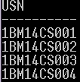
SQL select statement
student Table
usn | name | dep_num | marks
1BM14CS001 | Avinash | 10 | 100
1BM14CS002 | Balaji | 10 | 80
1BM14CS003 | Chandan | 10 | 45
1BM14CS004 | Dinesh | 10 | 60
1BM14IS005 | Avinash | 20 | 90
department Table
D_ID | D-Name
10 | CSE
20 | ISE
List out the USN’s of the students who belong to department number 10?

Slide 33
SQL select statement
student Table
usn | name | dep_num | marks
1BM14CS001 | Avinash | 10 | 100
1BM14CS002 | Balaji | 10 | 80
1BM14CS003 | Chandan | 10 | 45
1BM14CS004 | Dinesh | 10 | 60
1BM14IS005 | Avinash | 20 | 90
department Table
d_id | dep_name
10 | CSE
20 | ISE
Question
List out the USN’s of the students who belong to CSE department ?
Notes:
Select usn

Slide 34
SQL select statement
student Table
usn | name | dep_num | marks
1BM14CS001 | Avinash | 10 | 100
1BM14CS002 | Balaji | 10 | 80
1BM14CS003 | Chandan | 10 | 45
1BM14CS004 | Dinesh | 10 | 60
1BM14IS005 | Avinash | 20 | 90
department Table
d_id | dep_name
10 | CSE
20 | ISE
Question
List out the USN’s of the students who belong to CSE department ?
Notes:
Select usn

Slide 35
SQL select statement
student Table
usn | name | dep_num | marks
1BM14CS001 | Avinash | 10 | 100
1BM14CS002 | Balaji | 10 | 80
1BM14CS003 | Chandan | 10 | 45
1BM14CS004 | Dinesh | 10 | 60
1BM14IS005 | Avinash | 20 | 90
department Table
d_id | dep_name
10 | CSE
20 | ISE
Notes:
Select usn

Slide 36
SQL select statement: Aliasing
student Table
usn | name | dep_num | marks
1BM14CS001 | Avinash | 10 | 100
1BM14CS002 | Balaji | 10 | 80
1BM14CS003 | Chandan | 10 | 45
1BM14CS004 | Dinesh | 10 | 60
1BM14IS005 | Avinash | 20 | 90
department Table
d_id | dep_name
10 | CSE
20 | ISE
Notes:
select usn from student as s, department as d where s.dep_num=d.d_id and d.dep_name=‘CSE’;

Slide 37
SQL select statement: Distinct
Student Table
usn | name | dep_num | marks
1BM14CS001 | Avinash | 10 | 100
1BM14CS002 | Balaji | 10 | 80
1BM14CS003 | Chandan | 10 | 45
1BM14CS004 | Dinesh | 10 | 60
1BM14IS001 | Avinash | 20 | 90
Avinash
Balaji
Chandan
Dinesh
Avinash

Slide 38
SQL select statement: Distinct
Student Table
usn | name | dep_num | marks
1BM14CS001 | Avinash | 10 | 100
1BM14CS002 | Balaji | 10 | 80
1BM14CS003 | Chandan | 10 | 45
1BM14CS004 | Dinesh | 10 | 60
1BM14IS001 | Avinash | 20 | 90
Avinash
Balaji
Chandan
Dinesh

Slide 39
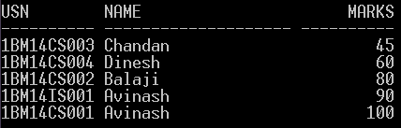
SQL select statement: Order By
Student Table
usn | name | dep_num | marks
1BM14CS001 | Avinash | 10 | 100
1BM14CS002 | Balaji | 10 | 80
1BM14CS003 | Chandan | 10 | 45
1BM14CS004 | Dinesh | 10 | 60
1BM14IS001 | Avinash | 20 | 90

Slide 40
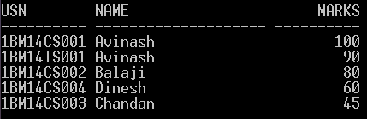
SQL select statement: Order By
Student Table
usn | name | dep_num | marks
1BM14CS001 | Avinash | 10 | 100
1BM14CS002 | Balaji | 10 | 80
1BM14CS003 | Chandan | 10 | 45
1BM14CS004 | Dinesh | 10 | 60
1BM14IS001 | Avinash | 20 | 90

Slide 41
SQL select statement: Order By
Student Table
usn | name | dep_num | marks
1BM14CS001 | Avinash | 10 | 100
1BM14CS002 | Balaji | 10 | 80
1BM14CS003 | Chandan | 10 | 45
1BM14CS004 | Dinesh | 10 | 60
1BM14IS001 | Avinash | 20 | 90
Question
List usn, name of the students who belong to department number 10 ordered by
ascending order of their marks ?
Notes:
List usn, name of the students who belong to department number 10 ordered by ascending order of their marks ?

Slide 42
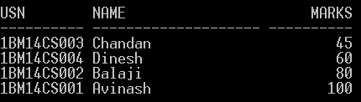
SQL select statement: Order By
Student Table
usn | name | dep_num | marks
1BM14CS001 | Avinash | 10 | 100
1BM14CS002 | Balaji | 10 | 80
1BM14CS003 | Chandan | 10 | 45
1BM14CS004 | Dinesh | 10 | 60
1BM14IS001 | Avinash | 20 | 90
Question
List usn, name of the students who belong to department number 10 ordered by
ascending order of their marks ?
Notes:
List usn, name of the students who belong to department number 10 ordered by ascending order of their marks ?

Slide 43
Activity: To do
Employee table
EMPNO | ENAME | JOB | MGR | HIREDATE | SAL | COMM | DEPTNO
7369 | SMITH | CLERK | 7902 | 17-Dec-80 | 800 |  | 20
7499 | ALLEN | SALESMAN | 7698 | 20-Feb-81 | 1600 | 300 | 30
7521 | WARD | SALESMAN | 7698 | 22-Feb-81 | 1250 | 500 | 30
7566 | JONES | MANAGER | 7839 | 02-Apr-81 | 2975 |  | 20
7654 | MARTIN | SALESMAN | 7698 | 28-Sep-81 | 1250 | 1400 | 30
7698 | BLAKE | MANAGER | 7839 | 01-May-81 | 2850 |  | 30
7782 | CLARK | MANAGER | 7839 | 09-Jun-81 | 2450 |  | 10
7788 | SCOTT | ANALYST | 7566 | 09-Dec-82 | 3000 |  | 20
7839 | KING | PRESIDENT |  | 17-Nov-81 | 5000 |  | 10
7844 | TURNER | SALESMAN | 7698 | 08-Sep-81 | 1500 | 0 | 30
7876 | ADAMS | CLERK | 7788 | 12-Jan-83 | 1100 |  | 20
7900 | JAMES | CLERK | 7698 | 03-Dec-81 | 950 |  | 30
7902 | FORD | ANALYST | 7566 | 03-Dec-81 | 3000 |  | 20
7934 | MILLER | CLERK | 7782 | 23-Jan-82 | 1300 |  | 10
Write SQL queries for the following
Display all the information of the Employee table ?
Display unique Jobs from Employee table?
List names of the employees in the ascending order of their Salaries ?
Notes:
Display all the information of the EMP table?
A) select * from emp;
Display unique Jobs from EMP table?
select distinct job from emp;
select unique job from emp;
List the emps in the asc order of their Salaries?
A) select * from emp order by sal asc;

Slide 44
Topics Covered in Today’s class
Unit 1: Basic queries in SQL
w.r.t SELECT statement
SQL operators: LIKE, IN, BETWEEN

Slide 45
Structured Query Language (SQL)
SQL can be divided into two parts:
1. The Data Manipulation Language (DML) and
2. The Data Definition Language (DDL)
1. DDL statements in SQL are:
CREATE DATABASE - creates a new database
ALTER DATABASE - modifies a database
CREATE TABLE - creates a new table
ALTER TABLE - modifies a table
DROP TABLE - deletes a table
2. DML part of SQL:
SELECT - extracts data from a database
UPDATE - updates data in a database
DELETE - deletes data from a database
INSERT INTO - inserts new data into a database

Slide 46
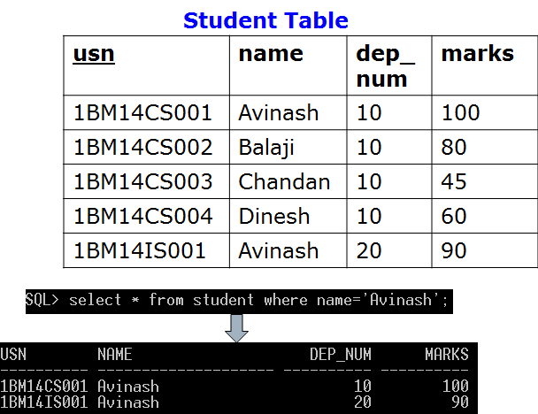
The SQL SELECT Statement
The SELECT statement is used to select data from a database.
The result is stored in a result table, called the result-set.
Note: SQL is not case sensitive. SELECT is the same as select.

Slide 47
w.r.t to SELECT SQL statement
1. SQL Alias: We can give a table or a column another name by using an alias.
SQL Alias Syntax for Tables
SELECT column_name(s)
FROM table_name AS alias_name;
SQL Alias Syntax for Columns
SELECT column_name AS alias_name
FROM table_name;
2. The DISTINCT keyword can be used to return only distinct (different) values.
SQL SELECT DISTINCT Syntax
SELECT DISTINCT column_name(s)
FROM table_name

Slide 48
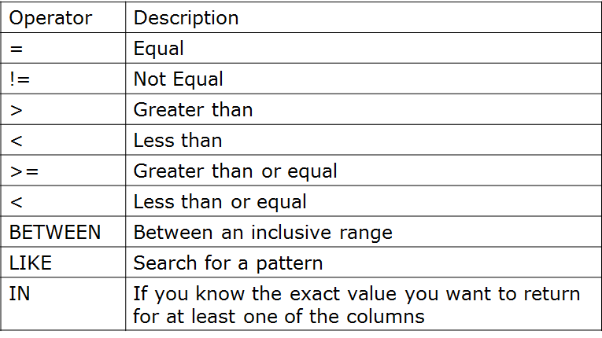
w.r.t to SELECT sql statement
3. The ORDER BY keyword is used to sort the result-set by a specified column.
SQL ORDER BY Syntax
SELECT column_name(s)
FROM table_name
ORDER BY column_name(s) ASC | DESC;
4. The WHERE clause is used to filter records. The WHERE clause is used to extract only those records that fulfill a specified criterion.
SQL WHERE Syntax
SELECT column_name(s)
FROM table_name
WHERE column_name operator value
With the WHERE clause, the following operators can be used:

Slide 49
Substring Pattern Matching: SQL LIKE Operator
The LIKE operator is used in a WHERE clause to search for a specified pattern in a column.
SQL LIKE Syntax
SELECT column_name(s)
FROM table_name
WHERE column_name LIKE pattern

Slide 50
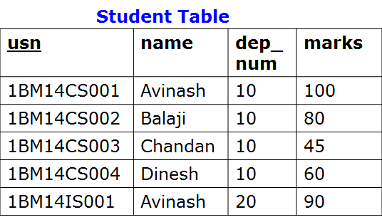
SQL LIKE Operator
The LIKE operator is used in a WHERE clause to search for a specified pattern in a column.
SQL LIKE Syntax
SELECT column_name(s)
FROM table_name
WHERE column_name LIKE pattern
Example: Write SQL statement to list the names starting with letter “A” from following student table.

Slide 51


SQL LIKE Operator
Write SQL statement to list the names starting with letter “A” from the following student table.

Slide 52
SQL LIKE Operator
Write SQL statement to list the names starting with letter “A” from the following student table.
Note:
Wildcard character %, A substitute for zero or more characters
Notes:
Case Sensitivity Case is significant in all conditions comparing character expressions that the LIKE condition and the equality (=) operators. You can use the UPPER function to perform a case-insensitive match, as in this condition:
UPPER(last_name) LIKE 'SM%'

Slide 53
SQL LIKE Operator
Question
Write SQL statement to list name of the students whose names end
with letter ‘h’?
Note:
Wildcard character %, A substitute for zero or more characters

Slide 54

SQL LIKE Operator
Question
Write SQL statement to list name of the students whose names end
with letter ‘h’?

Slide 55
SQL LIKE Operator
Question
Write SQL statement to list name of the students whose names
are having the substring ‘in’?
Note:
Wildcard character %, A substitute for zero or more characters

Slide 56

SQL LIKE Operator
Question
Write SQL statement to list name of the students whose names
are having the substring ‘in’?

Slide 57
SQL LIKE Operator
Question
Write SQL statement to list name of the students whose names
start with letter ‘A’ or ‘B’

Slide 58

SQL LIKE Operator
Question
Write SQL statement to list name of the students whose names
start with letter ‘A’ or ‘B’

Slide 59
SQL LIKE Operator
Question
Write SQL statement to list name of the students whose names
start with letter ‘A’ or ‘D’ but end with letter ‘h’

Slide 60

SQL LIKE Operator
Question
Write SQL statement to list name of the students whose names
start with letter ‘A’ or ‘D’ but end with letter ‘h’

Slide 61
SQL LIKE Operator
Question
Write SQL statement to list name of the students whose third letter in the
name is ‘a’ .

Slide 62

SQL LIKE Operator
Question
Write SQL statement to list name of the students whose third letter in the
name is ‘a’ .
Note:
An underscore (_) in the pattern matches exactly one character
A percent sign (%) in the pattern can match zero or more characters
underscore (_) and percent sign (%) are referred as wildcard characters

Slide 63
SQL Wildcard Characters
In SQL, wildcard characters are used with the SQL LIKE operator.
SQL wildcards are used to search for data within a table.
With SQL, the wildcards are:
Wildcard | Description
% | A substitute for zero or more characters
_ | A substitute for a single character
[charlist] | Sets and ranges of characters to match
[^charlist] or [!charlist] | Matches only a character NOT specified within the brackets
Notes:
The pattern can contain special pattern-matching characters:
An underscore (_) in the pattern matches exactly one character
A percent sign (%) in the pattern can match zero or more characters

Slide 64
SQL IN Operator
The IN operator allows you to specify multiple values in a WHERE clause.
SQL IN Syntax
SELECT column_name(s)
FROM table_name
WHERE column_name IN (value1,value2,...)

Slide 65
SQL IN Operator
The IN operator allows you to specify multiple values in a WHERE clause.
SQL IN Syntax
SELECT column_name(s)
FROM table_name
WHERE column_name IN (value1,value2,...)
Example: List USN's of the students with name equal to "Avinash" or "Dinesh" from the table above.

Slide 66

SQL IN Operator
The IN operator allows you to specify multiple values in a WHERE clause.
Example: List USN's of the students with name equal to "Avinash" or "Dinesh" from the table above.

Slide 67
SQL BETWEEN operator
The BETWEEN operator selects a range of data between two values. The values can be numbers, text, or dates.
SQL BETWEEN Syntax
SELECT column_name(s)
FROM table_name
WHERE column_name BETWEEN value1 AND value2
Example: List USN’s and Names of students whose marks is in between 40 and 80

Slide 68

SQL BETWEEN operator
The BETWEEN operator selects a range of data between two values. The values can be numbers, text, or dates.
Example: List USN’s and Names of students whose marks is in between 40 and 80

Slide 69
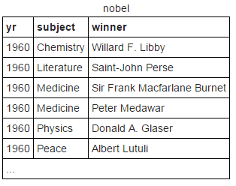
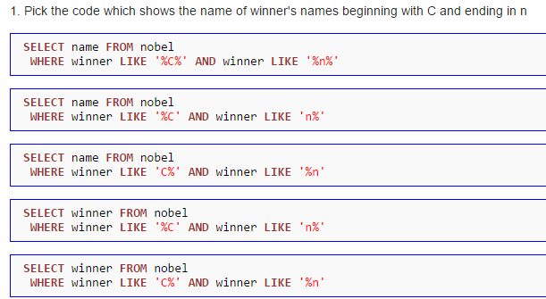
Activity To Do
Consider table of Nobel prize winners:
nobel(yr, subject, winner)
Answer the following

Slide 70
Activity To Do
Consider table of Nobel prize winners:
nobel(yr, subject, winner)
Answer the following

Slide 71
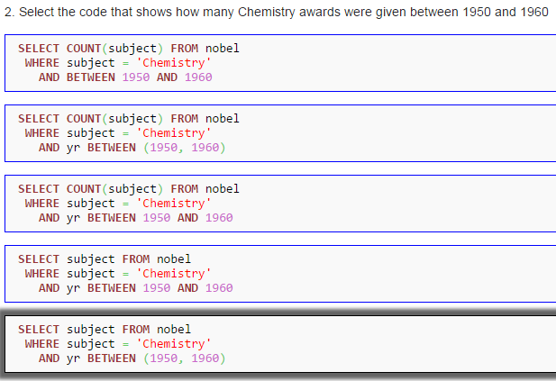
Activity To Do
Consider table of Nobel prize winners:
nobel(yr, subject, winner)
Answer the following

Slide 72
Activity To Do
Consider table of Nobel prize winners:
nobel(yr, subject, winner)
Answer the following

Slide 73
Aggregate Functions in SQL
Why we need aggregate functions ??
Example say we want find maximum marks scored by the students in the class.
We use aggregate function to group multiple rows together to form a single value output.

Slide 74
Topics Covered in Todays Class
Unit 1: Basic queries in SQL
Aggregate functions
Group BY Clause
Having Clause

Slide 75

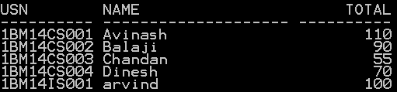
Arithmetic operators in Queries
Arithmetic operators for addition (+), subtraction (-), multiplication(*), and division (/) can be applied to numeric values or attributes with numeric domain.
Example:

Slide 76
Aggregate Functions in SQL
SQL aggregate functions return a single value, calculated from values in a column.
Useful aggregate functions:
AVG() - Returns the average value
COUNT() - Returns the number of rows
MAX() - Returns the largest value
MIN() - Returns the smallest value
SUM() - Returns the sum

Slide 77

Aggregate Functions in SQL
The AVG() Function
The AVG() function returns the average value of a numeric column.
SQL AVG() Syntax
SELECT AVG(column_name) FROM table_name
Find average marks of all the students in the class.

Slide 78
Aggregate Functions in SQL
SQL COUNT() Function
The COUNT() function returns the number of rows that matches a specified
criteria.
SQL COUNT(column_name) Syntax
The COUNT(column_name) function returns the number of values (NULL
values will not be counted) of the specified column:
SELECT COUNT(column_name) FROM table_name
SQL COUNT(*) Syntax
The COUNT(*) function returns the number of records in a table:
SELECT COUNT(*) FROM table_name
SQL COUNT(DISTINCT column_name) Syntax
The COUNT(DISTINCT column_name) function returns the number of
distinct values of the specified column:
SELECT COUNT(DISTINCT column_name) FROM table_name

Slide 79

Aggregate Functions in SQL
SQL COUNT(*) Syntax
The COUNT(*) function returns the number of records in a table.
.
Find total number of records in the above student table

Slide 80

Aggregate Functions in SQL
SQL COUNT(*) Syntax
The COUNT(*) function returns the number of records in a table.
Find total number of students who belong to department number
10

Slide 81

Aggregate Functions in SQL
SQL COUNT(column_name) Syntax
The COUNT(column_name) function returns the number of values
(NULL values will not be counted) of the specified column.
Find total number of students who have Email IDs

Slide 82
Aggregate Functions in SQL
What will be the out put of following SQL queries ?

Slide 83
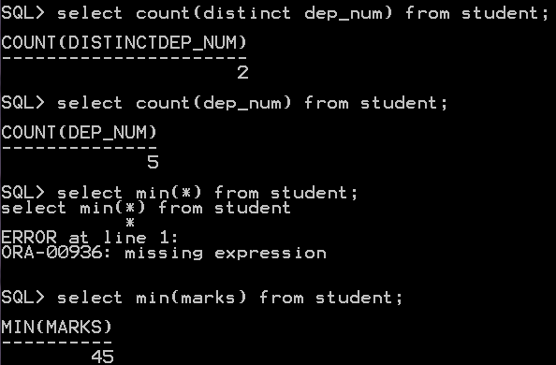
Aggregate Functions in SQL

Slide 84
SQL GROUP BY Statement
Why we need Group by Statement
Say we want to find total number of students by department wise.
Partition the set of records into groups based on certain criteria.
Groups are formed on the basis of certain attribute.
Aggregate functions are calculated for each group.

Slide 85
SQL GROUP BY Statement
The GROUP BY statement is used in conjunction with the aggregate functions to group the result-set by one or more columns.
SQL GROUP BY Syntax
SELECT column_name, aggregate_function(column_name)
FROM table_name
WHERE column_name operator value
GROUP BY column_name

Slide 86

SQL GROUP BY Statement
The GROUP BY statement is used in conjunction with the aggregate functions to group the result-set by one or more columns.
Find total number of students in each department

Slide 87
SQL GROUP BY Statement
Whether the following SQL queries will “Find total number of
students in each department”

Slide 88
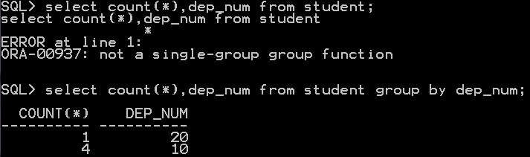
SQL GROUP BY Statement
Whether the following SQL queries will “Find total number of
students in each department”

Slide 89
SQL GROUP BY Statement
The GROUP BY statement is used in conjunction with the aggregate functions to group the result-set by one or more columns.
What will be the output of following SQL statement

Slide 90

SQL GROUP BY Statement
The GROUP BY statement is used in conjunction with the aggregate functions to group the result-set by one or more columns.
What will be the output of following SQL statement

Slide 91
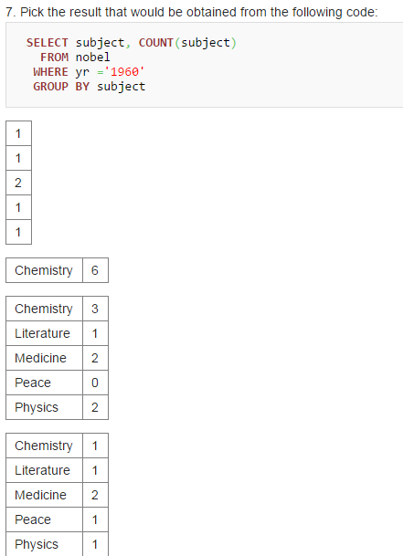
Answer the following

Slide 92
Answer the following

